Slide 1
C ++ STL Standard Template Library

Slide 2
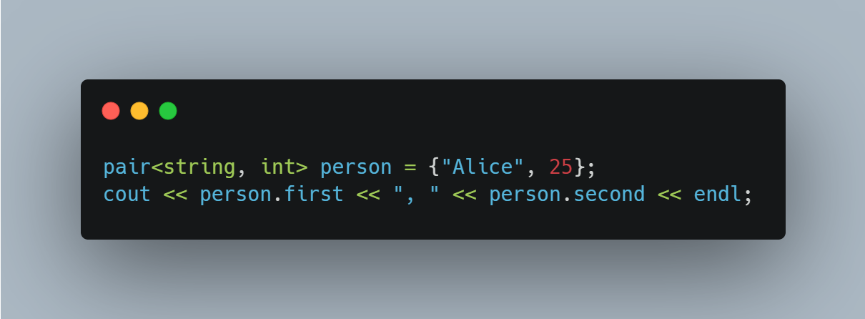
pair<T1, T2>

Slide 3
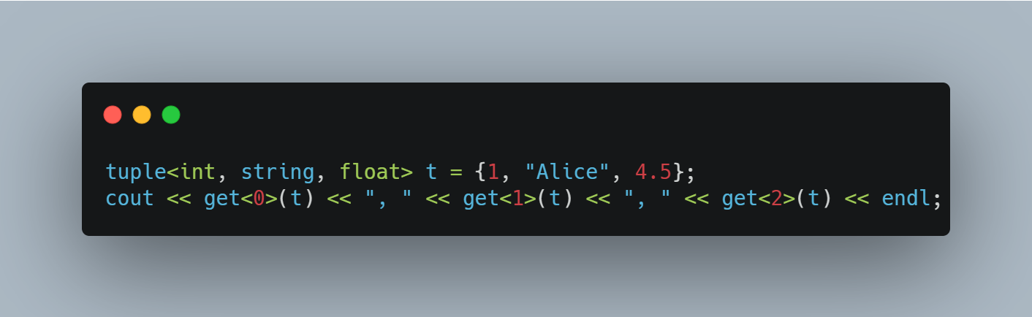
tuple<T1, T2, ...>

Slide 4
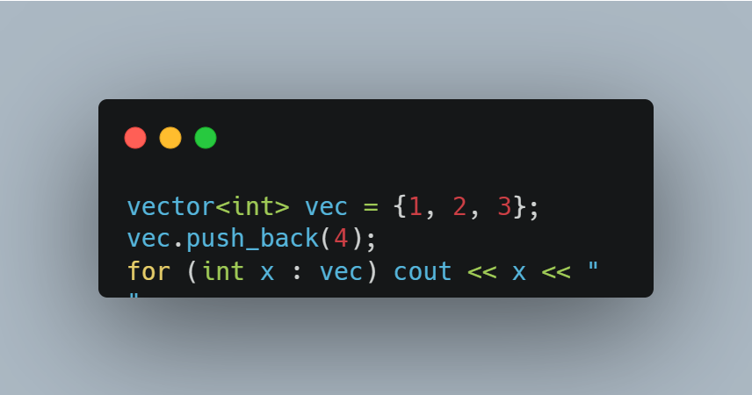
vector<T1, T2, ...>

Slide 5
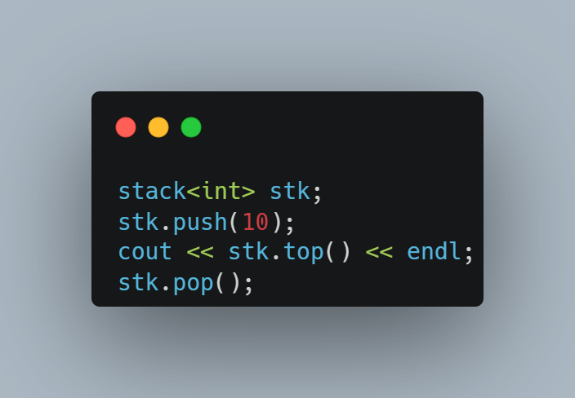
stack<T1>

Slide 6
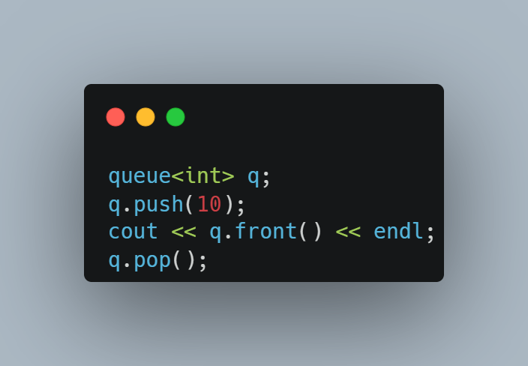
queue<T1>

Slide 7
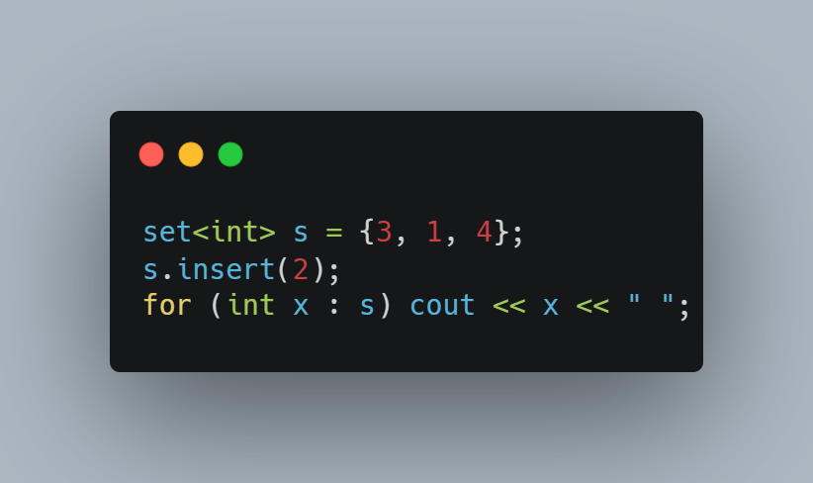
set<T1>

Slide 8
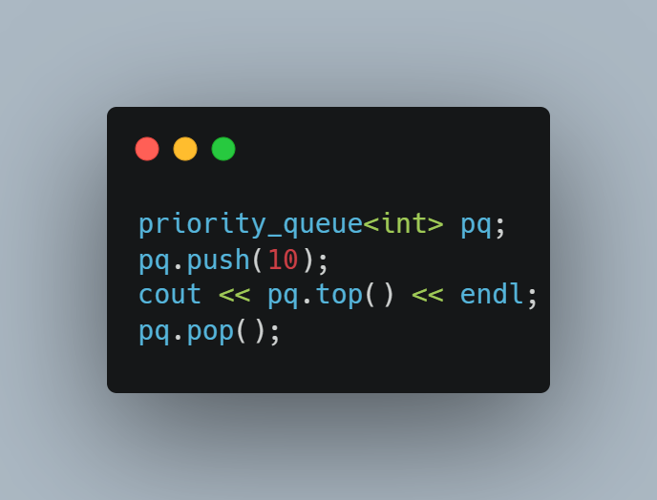
priority_queue<T1>

Slide 9
set vs priority_queue
Feature | std::set | std::priority_queue
Ordering | Sorted (ascending by default) | Not sorted; based on priority
Underlying Structure | Balanced tree (e.g., Red-Black Tree) | Heap (binary heap)
Duplicates | No duplicates | Duplicates allowed
Access | Iterate through sorted elements | Access only top element (highest/lowest priority)
Insertion Complexity | O(log n) | O(log n)
Removal Complexity | O(log n) | O(log n) (pop top element)
Use Case | Unique elements in sorted order | Efficient top-priority element access (e.g., scheduling)

Slide 10
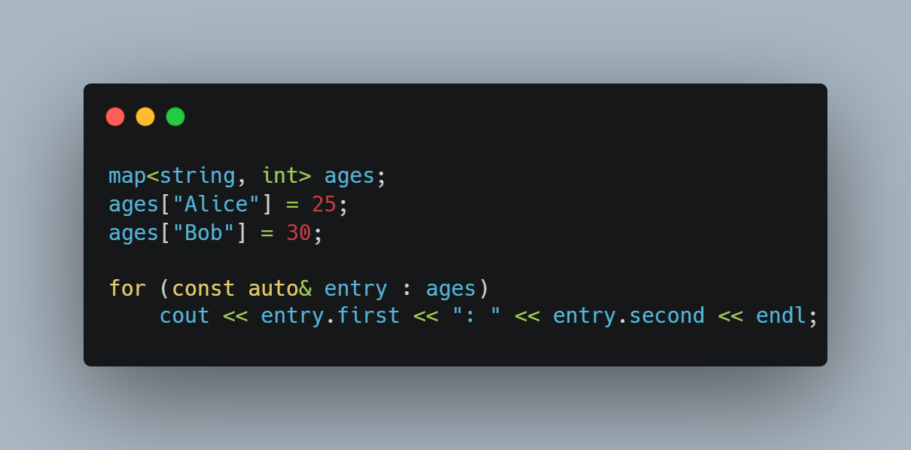
map<key, value>

Slide 11
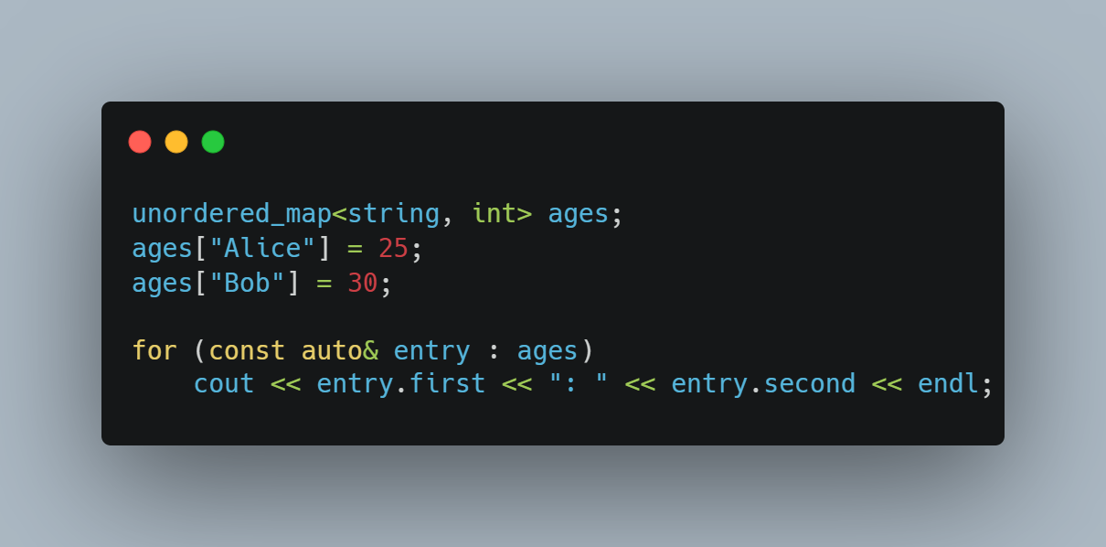
unordered_map<key, value>

Slide 12
map vs unordered_map
Feature | map | unordered_map
Ordering | Sorted by key | No specific order
Time Complexity | O(log n) | O(1) on average
Underlying Structure | Balanced Tree (e.g., Red-Black Tree) | Hash Table
Duplicate Keys | Not allowed | Not allowed
Insertion Order | Not preserved | Not preserved
Use Case | When sorted order is needed | When performance is critical

Slide 13
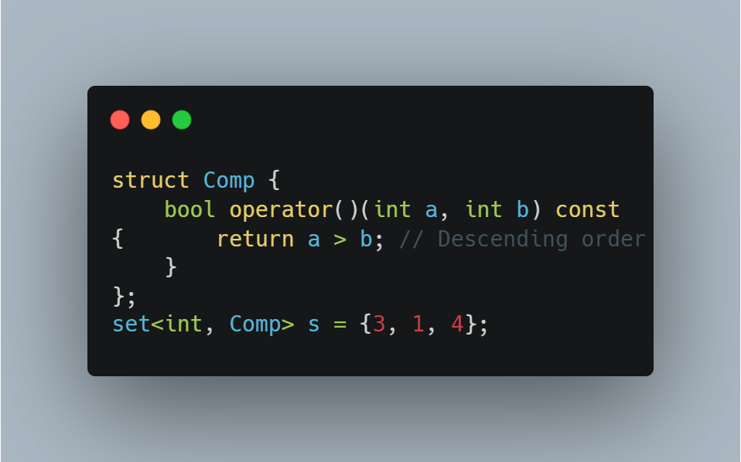
Custom Comparator

Slide 14
Resources
https://cplusplus.com/reference/vector/vector/
https://cplusplus.com/reference/utility/pair/
https://cplusplus.com/reference/tuple/tuple/
https://cplusplus.com/reference/stack/stack/
https://cplusplus.com/reference/queue/queue/
https://cplusplus.com/reference/set/set/
https://cplusplus.com/reference/unordered_map/unordered_map/
https://cplusplus.com/reference/queue/priority_queue/
https://en.cppreference.com/w/cpp/container

Slide 15
Thank You

